Slide 1

Pistachio Type Classification
Bryan Crigger & Nolan Arendt

Slide 2
INTRODUCTION
In this project, we explore the use of Convolutional Neural Networks to classify images of pistachios into different species.
The primary goal of our project is to accurately classify pistachios into their respective species using recognition techniques.
Classifying pistachios correctly is crucial for quality control in the food industry.
Our project focuses on two main species of pistachios (Kirmizi and Sriit) using a dataset that contains over 2,000 images for our training and testing.

Slide 3
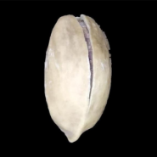
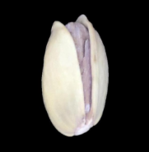
COMPARISON OF SPECIES
Kirmizi Pistachio
Siirt Pistachio
Origin: Primarily grown in Gaziantep region of Turkey.
Appearance: Known for their red-hued shells, smaller size, and oval shape.
Origin: Predominantly cultivated in the Siirt province of Turkey.
Appearance: Characterized by their larger size, greener shells, and rounder shape.

Slide 4
DATA EXPLORATION
43%
57%
Siirt Training Images
Kirmizi Training Images
The dataset contains 916 training images for Siirt pistachios.
The dataset contains 1,232 training images for Kirmizi pistachios.
A balanced dataset is essential in machine learning to prevent a model bias. Although there is a slight imbalance in our dataset, it is within acceptable limits for effective model training.

Slide 5
IMAGE DATA AUGMENTATION
Enhanced dataset diversity and size to improve the model's robustness and prevent overfitting.
Utilized ImageDataGenerator for real-time data augmentation during model training.
Separate data generators for training, testing, and validation sets with specific augmentation techniques for each.
Application of transformations:
  Zooming (15%)
  Width Shifting (20%)
  Height Shifting (20%)
  Shear (15%)

Slide 6
DATA SPLITTING STRATEGY
Training 70%
Validation 15%
Test 15%
One split for the training data. This will be used for model training and learning.
One split for validation. This will be used for tuning the model's performance.
One split for testing data. This will be used for final evaluation.
Random splitting for unbiased data distribution across each set we created.

Slide 7
MODEL ARCHITECTURE: EfficientNetB0
Base Model: EfficientNetB0
  Chosen for its efficiency in image classification tasks.
  Pre-trained on ImageNet, which was leveraged for feature extraction.
EfficientNetB0 Modifications
  Added a Flatten layer to transform 2D features into a 1D vector.
  Included a Dropout layer with a rate of 0.25 to prevent the model from overfitting.
Dense Layer Configuration
  One Dense layer with 128 nodes, employing a ReLu activation for non-linearity.
  Final Dense layer with a single node, using Sigmoid activation for binary output.
Compilation and Training Strategy
  Model compiled with binary cross entropy loss and Adam optimizer.
  Utilized EarlyStopping with a patience of 10 epochs, all while monitoring validation accuracy.
Training Execution and Monitoring
  Training executed up to 30 epochs, with EarlyStopping based on the validation accuracy.
  Utilized TensorBoard for training process visualizations and analysis.

Slide 8
FINE TUNING OF THE MODEL
Layer Selection
  Unfroze the last 15 layers of the model for training.
  Kept the earlier layers frozen to retain learned features.
Model Recompilation
  Model recompiled with a lower learning rate of 0.000001 to make subtle adjustments.
  Continued to use binary cross entropy and Adam optimizer.
Training Strategy
  Employed EarlyStopping with a patience of 5 epochs, monitoring validation accuracy for optimal stopping.
  Adjusted class weights in training to maintain the balance.
Epoch Configuration and Execution
  Trained the model for an additional 20 epochs during the fine-tuning phase of our construction.
  Utilized Tensorboard for monitoring and visualizing the fine-tuning process.

Slide 9
EfficientNetB0 MODEL PERFORMANCE
Test Data Evaluation
  The model achieved a test accuracy of 98.46% with a loss of 7.30% on the testing set.
  The high accuracy indicates the model’s strong ability to generalize new and unseen data.
Precision & Recall Analysis
  Precision for our first species Kirmizi was roughly 57%, with a perfect recall of 100%.
  Precision for our second species Siirt was 0%, with a recall of 0% indicating a need for improvement in the model.
F1-Score Insights
  The F1-score for Kirmizi was 73%, highlight a good balance between precision and recall.
  The F1-score for Siirt was 0%, highlighting a significant area of improvement in the model.

Slide 10
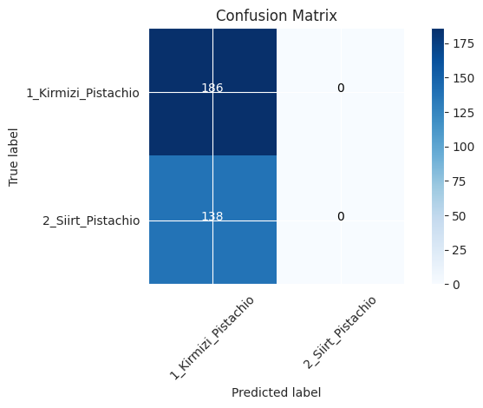
MODEL PERFORMANCE CONTINUED
Accuracy and Weighted Averages
  Overall accuracy of 57% on the test set.
  The weighted average for precision, recall, and F1-scores were 33%, 57%, and 42% respectively.
Confusion Matrix Observations
  The confusion matrix showed all 186 instances of Kirmizi correctly classified, but all 138 instances of Siirt were misclassified.
  This suggest the model is highly biased towards the Kirmizi species and struggles to identify Siirt.

Slide 11
MODEL ARCHITECTURE: VGG16
Base Model: VGG16
  Adapted from ImageNet pre-training
  Layer Modification: Unfroze all but the last two layers for deeper fine-tuning
VGG16 Modifications
  Added a Global Average Pooling 2D layer for feature reduction
  Two Dense layers (2048 and 1024 nodes with ReLu activation) with increased units and an additional layer for complex feature extraction
Dropout for Regularization
  First Dropout layer with 0.6 rate to reduce overfitting
  Second Dropout layer with 0.5 rate, enhancing the models generalization
Optimization and Compilation
  Utilized Adam optimizer with a learning rate of 0.0001
  Binary cross-entropy loss function, tracking the accuracy metric
Training and Validation Strategy
  Training executed up to 50 epochs, class weight adjustments to address the data imbalance
  Implemented EarlyStopping to prevent overfitting

Slide 12
VGG16 MODEL PERFORMANCE
Test Data Evaluation
  The model achieved a test accuracy of 96.31% with a loss of 10.49% on the testing set.
  The high accuracy indicates the model’s strong ability to generalize new and unseen data.
Precision & Recall Analysis
  Precision for our first species Kirmizi was roughly 60%, with a high recall of 62%.
  Precision for our second species Siirt was 47%, with a recall of 45% indicating a need for improvement in the model but significant improvement over the first model.
F1-Score Insights
  The F1-score for Kirmizi was 61%, highlighting a good balance between precision and recall.
  The F1-score for Siirt was 46%, highlighting an area of improvement in the model.

Slide 13
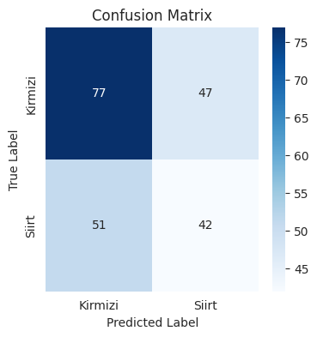
MODEL PERFORMANCE CONTINUED
Accuracy and Weighted Averages
  Overall accuracy of 54.84% on the test set.
  The weighted average for precision, recall, and F1-scores were 54%, 54%, and 54% respectively.
Confusion Matrix Observations
  The confusion matrix shows 77 instances of Kirmizi correctly classified, and 42 instances of the Siirt were correctly classified.
  This suggest the model is performing better for the Kirmizi, and correct less than half of the time for Siirt images.

Slide 14
CONCLUSION
Developed a convolution neural network using EfficientNetB0 and VGG16. Both models achieved a relatively high accuracy in classifying pistachio images.
Demonstrated the model’s ability to effectively learn and differentiate between the Kirmizi and Siirt pistachio species.
Addresses initial model bias towards Kirmizi pistachios through dataset balancing and modeling tuning strategies.
Highlighted the significance of continuous model evaluation and model tuning in this machine learning exercise.

Slide 15
Bryan Crigger
LinkedIn: https://www.linkedin.com/in/bryancrigger/
Email: bcrigger@syr.edu
Nolan Arendt
LinkedIn: https://www.linkedin.com/in/nolanarendt/
Email: nnarendt@syr.edu

